Slide 1

Smart Health Care System by
Dishant Kumar Kushwaha
Vantika Agarwal
Ashwani Kumar
Anjali Yadav
Shivani Bharti

Slide 2
OUTLINE
Introduction
HMS
Symptom Checker
Existing System
Proposed System
Modules
Functionality
Future Enhancements

Slide 3
Introduction
Goal: To develop a web based application by integrating HMS and Symptom checker tool.
A hospital or healthcare center is a full-time activity zone. Hundreds of patients get treated for a variety of problems. Since a large volume of data gets generated on the daily basis, maintaining it in conventional methods is highly difficult.
IT-based Hospital Management System (HMS as they are referred to) make the life easy. These smart and efficient systems take care of operational aspects so that the healthcare center can concentrate on enhanced patient care.
Smart Health Care system (HCS) is a computer or web-based system that facilitates managing the functioning of the hospital or any medical set up but with a symptom checker tool.

Slide 4
HMS
Installing an IT-based HMS brings incredible operational efficiency and speed.
Data management becomes simple.
It is a statutory requirement.
Top management gets at-a-glance view.
Keeps operational expenses under control.
Reduces the dependency on human resources.
Offers the interface to extract and retrieve data quickly.
A state-of-the-art healthcare center can’t survive without it.

Slide 5
Symptom Checker
Symptom checkers are the tools for self-diagnosis.
Symptom checkers make a diagnosis of a disease based on the data on the specificity of symptoms.
May be less effective than physicians in diagnostic accuracy for now.
Diagnostic accuracy of symptom checkers can be improved after appropriate feedback.
Useful to provide the access to health care in low resource settings such as in rural areas or developing countries.
Examples: WebMD symptom checker, Mayo Clinic symptom checker, Healthline symptom checker.
Notes:
Members of the public are increasingly using the internet to research their health concerns.
For example, the United Kingdom’s online patient portal for national health information, NHS Choices, reports over 15 million visits per month.
More than a third of adults in the United States regularly use the internet to self-diagnose.
Self-diagnosis usually starts with search engines like Google, Bing, or Yahoo. However, internet search engines can lead users to confusing.
The probability of patients receiving at least one medicine for secondary prevention of cardiovascular disease was 19.8% in low-income countries.

Slide 6
Existing System
No ERP provides HMS and Symptom checker tool as a single suite.
Not many reliable Symptom checkers for initial diagnosis.
Multiple symptoms leading to inconsistent results.
Medical records about the Patient visit are not available online.
Patients/Users cannot directly interact with the doctors.
Implementing or upgrading an ERP is very expensive.

Slide 7
Proposed System
The proposed system combines the functionality of a Hospital Management System and Symptom checker, which is why it is named as Smart Health Care System.
Integrating both HMS and symptom checker makes it easier for both the patients and doctors, making it first of its kind.
Patients will be able to use the symptom checker for initial diagnosis and can book an appointment with the doctor then and there, send a query to the doctor based on his/her symptoms and results given by the symptom checker.
Doctor is provided with access to reply to the patients’ queries.
HMS with a symptom checker makes the co-ordination between a doctor and patient easy and hassle free.

Slide 8
Modules
Doctor module
Patient module
Admin module
Disease Identification module

Slide 9
Doctor Module
Doctor can manage his/her profile.
Doctor can view his/her schedule.
Doctor can manage his/her appointments.
Doctor can update Patient reports.
Doctor can reply to the Patient queries.
Doctor can use symptom checker tool.

Slide 10
Patient Module
Patient can manage his/her profile.
Patient can view the list of doctors.
Patient can book an appointment.
Patient can make bill payment.
Patient can view his medical reports.
Patient can send queries to the Doctor.
Patient can use symptom checker tool.
Patient can provide feedback about the quality of treatment.

Slide 11
Admin Module
Admin is the data owner.
Has complete access to all the modules in the system.
Access to Doctor records.
Access to Patient records.
Access to billing records.
Add, delete and update departments.
Full control over Symptom checker tool.
Access to all the transactions happening in the system.

Slide 12
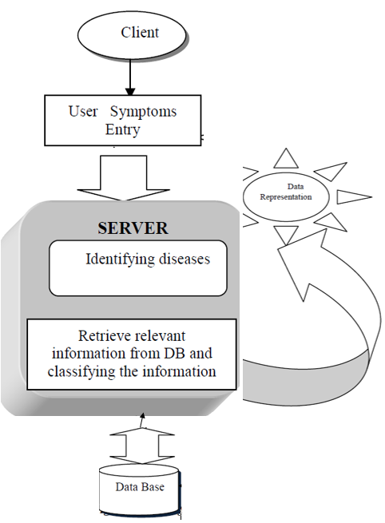
Disease Identification Module
Provides an efficient Symptom checker tool for self-diagnosis.
Input: User symptoms
Output: Likely Diagnoses
Patient is provided an option to interact with the doctor based on the diagnosis report.

Slide 13
Use Case Diagram

Slide 14
Activity Diagram

Slide 15
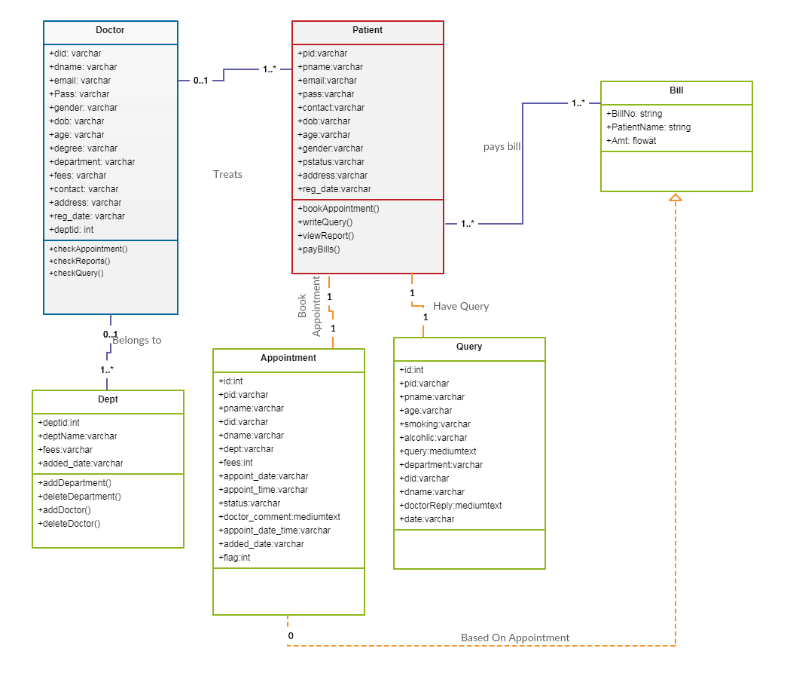
Class Diagram

Slide 16
System Requirements
Operating System : Windows 10
User Interface : HTML, CSS, Bootstrap
Scripting : JavaScript
Programming Language : Java
Web Applications : Servlet, JSP
IDE/Workbench : NetBeans IDE 8.2 , Eclipse IDE
Database : MySQL
Server : Apache Tomcat 9.0
Tested on : Google Chrome

Slide 17
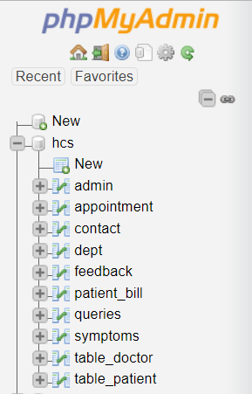
Tables

Slide 18
Functionality
Registration
Login
Appointment
Billing
Reports
Symptom Checker
Queries
Feedback Form
Contact Us

Slide 19
Future Enhancements
Integrating Blood bank system.
Integrating Diagnostic center system.
Adding payment gateway.
Adding additional modules to maintain Staff data.
Improving symptom checker tool with more reliable data.

Slide 20
Conclusion
The proposed system is successfully designed and tested.
Successfully integrates Hospital Management system and symptom checker tool.
Symptom checker tool developed displays the accurate results depending on the dataset.
Enhancements are to be made before bringing this product into market as a complete business suite.

Slide 21
THANK YOU

